Slide 1
SENSORS USED
HC-SR04
Working Principle: The HC-SR04 sensor operates on the principle of echolocation, similar to how bats navigate. It emits ultrasonic sound waves (inaudible to the human ear) and measures the time it takes for the sound waves to bounce back after hitting an object. By knowing the speed of sound in the air, it can calculate the distance to the object.
Components: The HC-SR04 module consists of several key components, including:
> Ultrasonic Transmitter: Emits high-frequency sound waves.
> Ultrasonic Receiver: Detects the reflected sound waves.
> Control Circuit: Manages the timing and distance calculation.

Slide 2
Arduino and Raspberry Pi Compatibility:
The HC-SR04 sensor is widely used with microcontrollers like Arduino and single-board computers like Raspberry Pi. Libraries and code examples are available for easy integration into your projects.
Applications:
The HC-SR04 sensor is versatile and finds applications in various projects, including obstacle avoidance for robots, measuring liquid levels in tanks, parking assist systems, and distance measurement in IoT applications.

Slide 3
ESP32
Dual-Core Processor:
The ESP32 features two Tensilica Xtensa LX6 microprocessor cores. These dual cores can be used to handle different tasks simultaneously, making it suitable for multitasking applications.
Wireless Connectivity:
The ESP32 is known for its extensive wireless capabilities. It supports both Wi-Fi (802.11b/g/n) and Bluetooth (Bluetooth Classic and BLE) communication. This makes it suitable for IoT projects requiring wireless connectivity.
Integrated Peripherals:
It includes a variety of peripherals such as GPIO pins, UART, SPI, I2C, PWM, and more, making it suitable for interfacing with various sensors and actuators.
Ultra-Low Power Consumption:
The ESP32 is designed for power efficiency and offers different power modes to conserve energy, making it suitable for battery-powered applications.

Slide 4
Rich Development Ecosystem:
There are various software development platforms and IDEs available for programming the ESP32, including the Arduino IDE, PlatformIO, and the official Espressif IDF (IoT Development Framework).
Security Features:
The ESP32 has built-in security features like secure boot and flash encryption to protect your applications and data.
Support for Over-the-Air (OTA) Updates:
This feature allows you to update the firmware of your ESP32 remotely, making it easier to maintain IoT devices in the field.
Wide Operating Voltage Range:
The ESP32 can operate within a wide voltage range, typically from 2.2V to 3.6V, making it compatible with a variety of power sources
Bluetooth Audio and Dual Mode:
It supports both classic Bluetooth and Bluetooth Low Energy (BLE), making it suitable for audio streaming and IoT applications.

Slide 5
Hardware Security Acceleration:
Some versions of the ESP32 include hardware acceleration for cryptographic operations, which enhances the security of your applications.
Variants:
There are several variants of the ESP32, each with its specific features and capabilities. For example, the ESP32-WROOM-32 is a common module used for development.
The ESP32 is widely used in various IoT and embedded systems projects, including home automation, smart devices, environmental monitoring, and more. Its versatility, low cost, and extensive development ecosystem have contributed to its popularity among developers and makers.

Slide 6
Specifications:
Operating Voltage: Typically operates at 5V DC.
Measurement Range: The HC-SR04 can measure distances accurately within a range of 2 cm (0.79 inches) to 4 meters (13.1 feet) with a resolution of about 3 mm.
Accuracy: It provides reasonably accurate distance measurements, but the precision may decrease with highly reflective or irregularly shaped objects.
Operating Angle: The sensor has a wide-angle of approximately 15 degrees, which can be important for some applications.
Trigger and Echo Pins: The module has two pins, namely Trigger (Trig) and Echo, which are used for controlling the sensor and receiving measurement data, respectively.
Operating Procedure:
To measure the distance, you need to send a short 10-microsecond pulse to the Trigger pin, which initiates the ultrasonic transmission.
The sensor will then wait for the sound waves to bounce back. When it detects the reflected waves, it sets the Echo pin to a high state.
You can measure the time between the trigger pulse and the moment when the Echo pin goes high to calculate the distance.

Slide 7
Preprocessor Directives:
This section defines some constant values such as template ID, template name, and authentication token for connecting to the Blynk IoT platform.
Library Inclusions:
The program includes several libraries for WiFi connectivity, Blynk integration, and client management.
Global Variables:
Various global variables are declared, including variables for storing distances, counters for entering and leaving an area, and pin assignments for LEDs and ultrasonic sensors.
BlynkTimer:
The program defines a BlynkTimer named "timer." This timer is used to trigger a specific function at regular intervals.
Distance Measurement Functions:
Two functions, get_distance1() and get_distance2(), are defined for measuring distances using ultrasonic sensors. These functions are called periodically by the timer.

Slide 8
myTimer Function:
This function is called at regular intervals by the Blynk timer. It performs the following tasks:
Measures the distance from the two ultrasonic sensors.
Compares the distances and keeps track of the number of times someone enters and leaves the area.
Updates the Blynk app with the counts and the current state of being inside or outside the area.
Setup Function:
In the setup() function, the program initializes the following:
Serial communication for debugging.
Pin modes for LED and ultrasonic sensor trigger and echo pins.
Blynk connection using the provided authentication token, network SSID, and an empty password.
Sets the timer interval for calling the myTimer function every 1000 milliseconds (1 second).
Loop Function:
The loop() function mainly runs the Blynk and timer services by calling Blynk.run() and timer.run().

Slide 9
Blynk Template Settings:
The program starts by defining three constants, BLYNK_TEMPLATE_ID, BLYNK_TEMPLATE_NAME, and BLYNK_AUTH_TOKEN. These are related to the Blynk IoT platform and are used for authenticating and connecting your device to the Blynk cloud service.
Variable Declarations:
The code declares various integer variables to store the duration and distance measurements from two distance sensors (distance1 and distance2). It also tracks the number of objects that have entered, left, and are currently inside the monitored area.
Pin Definitions:
The program defines several constants that represent the pins for LEDs, trigger and echo pins of two ultrasonic distance sensors (HC-SR04). For example, LED is set to pin 2, and PIN_TRIG1, PIN_ECHO1, PIN_TRIG2, and PIN_ECHO2 correspond to pins 15, 14, 13, and 12, respectively.
Wi-Fi and Blynk Configuration:
The setup() function initializes serial communication, sets the pin modes, and connects to the Wi-Fi network using the specified SSID and password. It then establishes a connection with the Blynk cloud using the provided authentication token, SSID, and password.

Slide 10
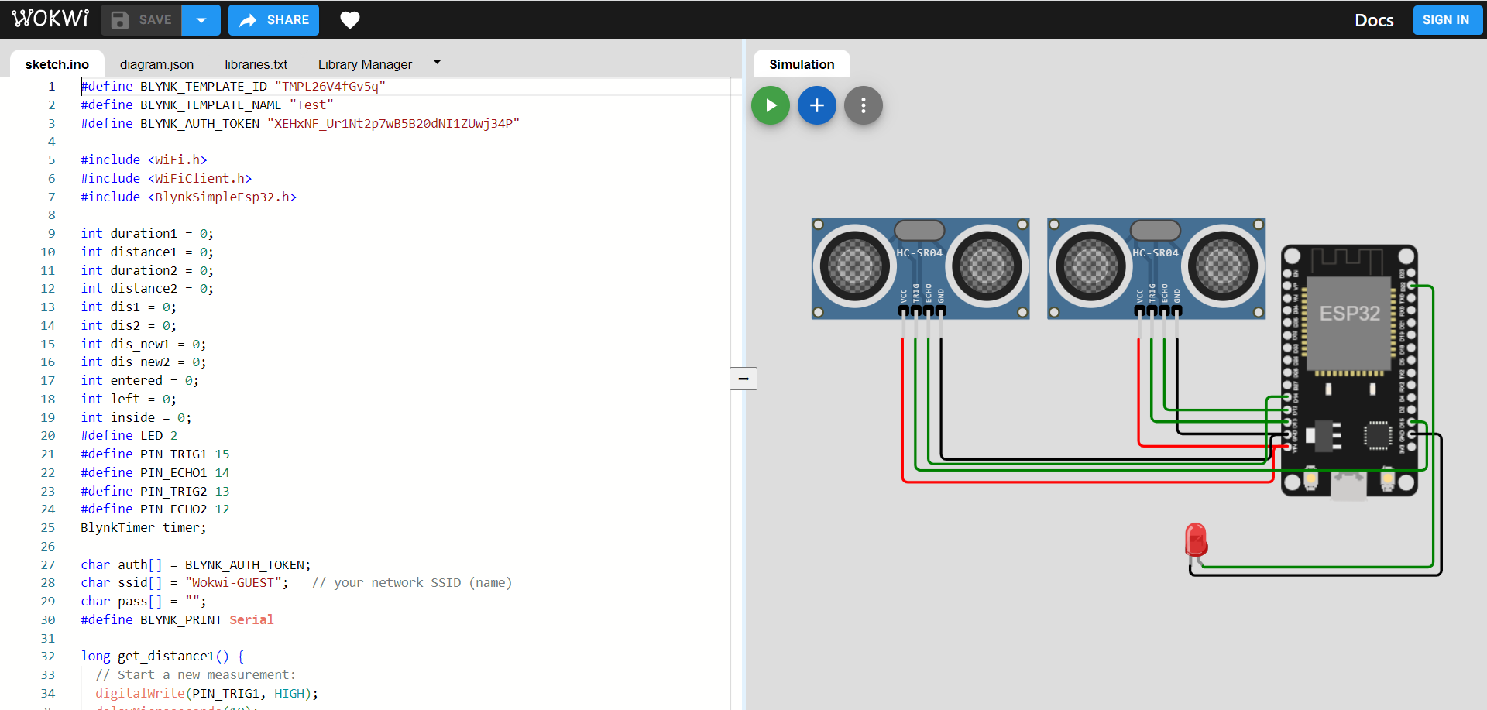
C++ Program

Slide 11
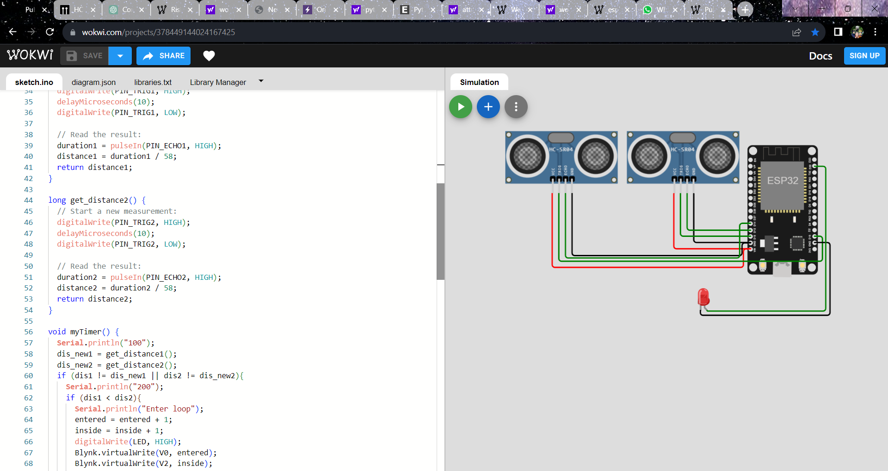

Slide 12
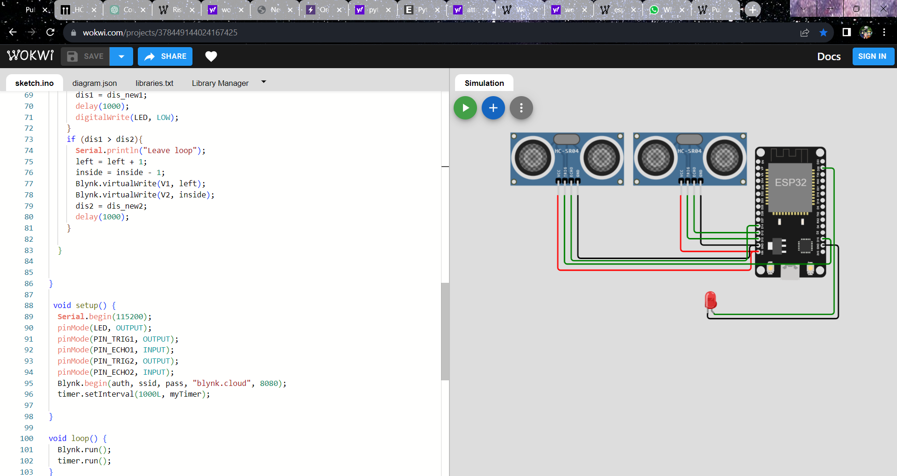

Slide 13
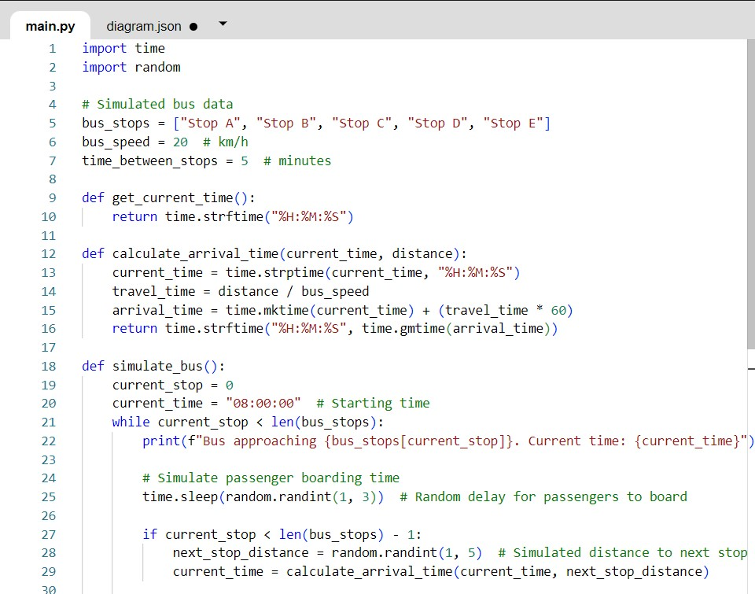
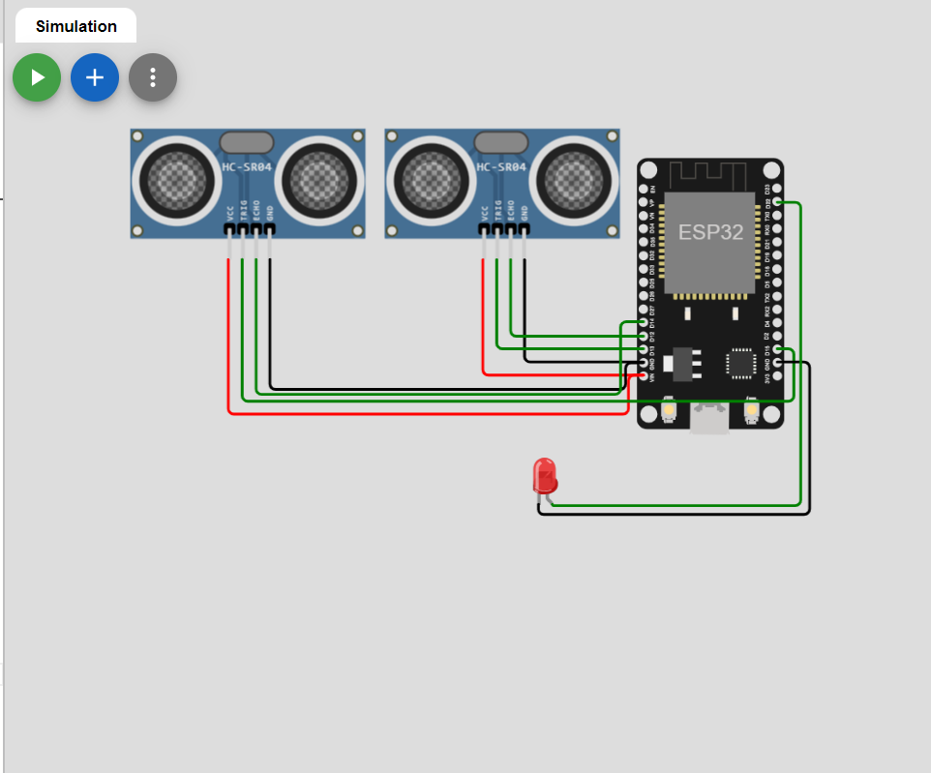
Python Program

Slide 14
